Slide 1
Optimization and Gradient Descent
Lecture 12
The core algorithm of modern machine learning

Slide 2


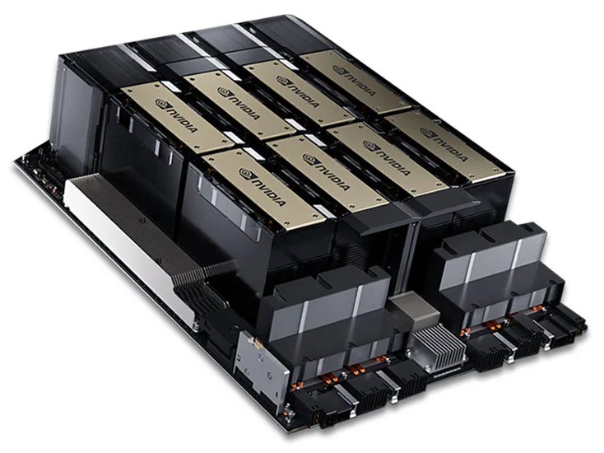



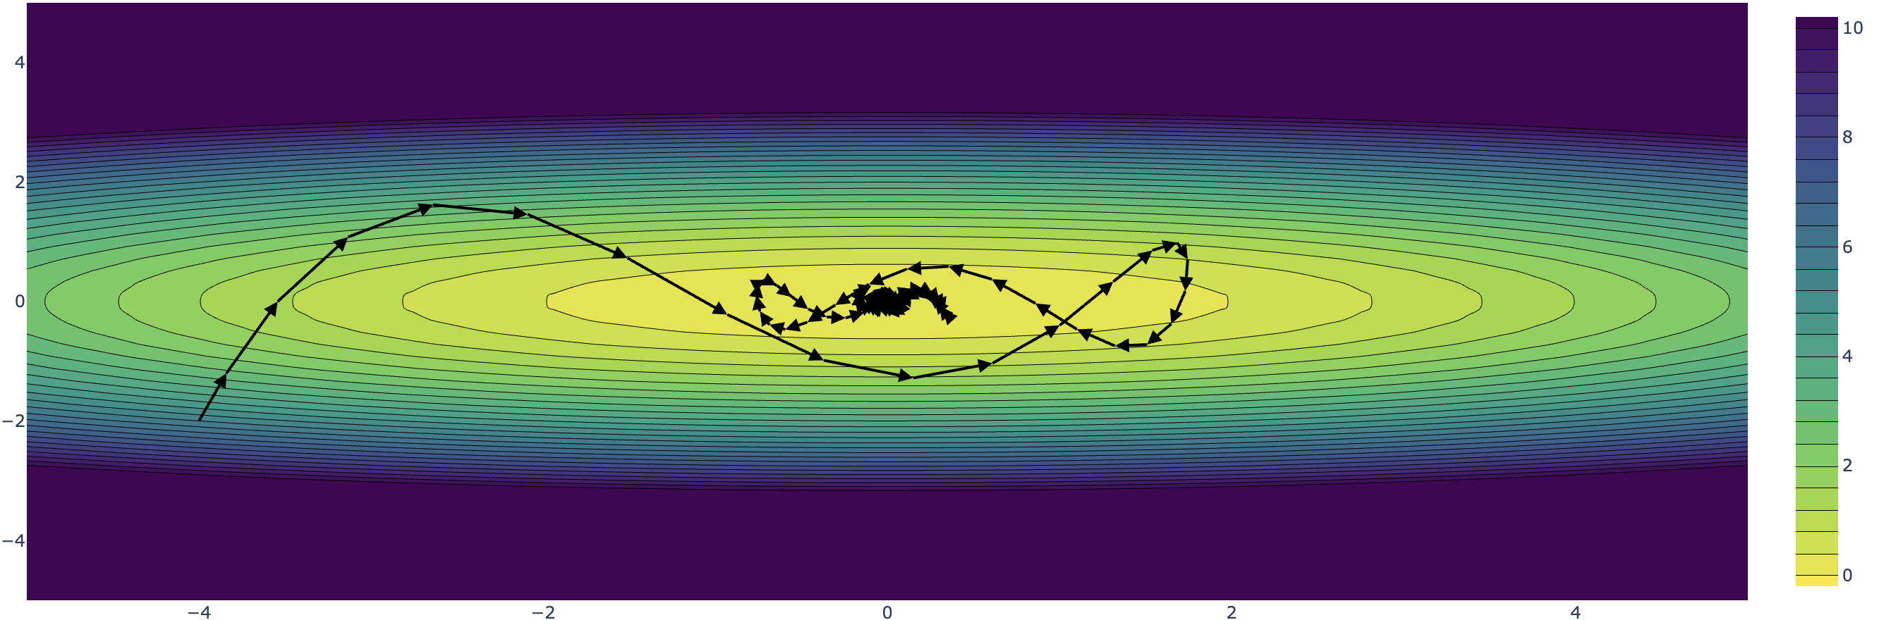


Key Factors in Generative AI Revolution
1846379
$$\ln{p\left({\text{Word}}_{n} |{ \left\{{\text{Word}}_{i}\right\}}_{i=1}^{n−1}\right)}$$
Data
Loss Functions
Compute
Neural
Architectures
Robbins–Monro 1951
Stochastic Gradient Descent
Automatic Diff.

Slide 3
The General Optimization Problem

Slide 4
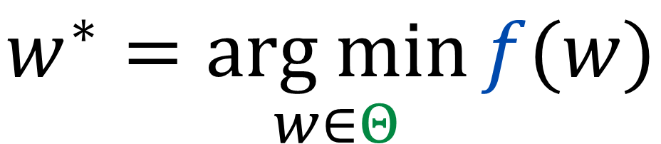
The General Optimization Problem
Most problems in ML can be reduced to the following general optimization problem
Objective Function
$$w^{∗}=\underset{w∈Θ}{arg min}{f(w)}$$
Solution
(Learned Parameters)
Constraints

Slide 5



Optimization Constraints
The constraints define the valid set of parameters.
$$w^{∗}=\underset{w∈Θ}{arg min}{f(w)}$$
The most common case in ML is unconstrained optimization in which $Θ=ℝ^{d}$.
In some cases, there may be integer (e.g., $Θ=ℤ^{d}$) or probability constraints:
$$Θ=\left\{w | w∈ℝ^{d}, 0≤w≤1, \sum{w_{i}}=1\right\}$$
Constraints
Solution
(Learned Parameters)
For the rest of this lecture, we will focus on the unconstrained setting. $$Θ=ℝ^{d}$$

Slide 6


The Objective Function
The shape of the objective function plays a big role in the complexity of solving the optimization problem.
Objective Function
The Objective Function in ML is often referred to as the loss or error function and depends on the data.
$$f\left(w\right)=E[w;𝔇]$$
$$w^{∗}=\underset{w∈Θ}{arg min}{f(w)}$$
Solution
(Learned Parameters)
Constraints

Slide 7
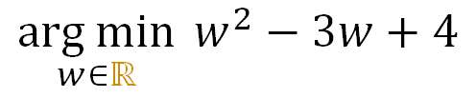
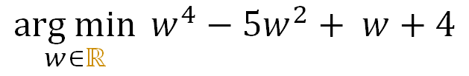
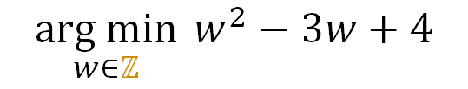
Examples Optimization Problems
$$\underset{w∈ℝ}{arg min}{ w^{2}−3w+4}$$
$$\underset{w∈ℤ}{arg min}{ w^{2}−3w+4}$$
$$\underset{w∈ℝ}{arg min}{ w^{4}−5w^{2}+ w+4}$$
Local Minima
Discrete
Global Minima
Multiple Minima
How do we solve these optimization problems?
What properties of the objective function make it “easier” to solve?
Plots in demo notebook.

Slide 8
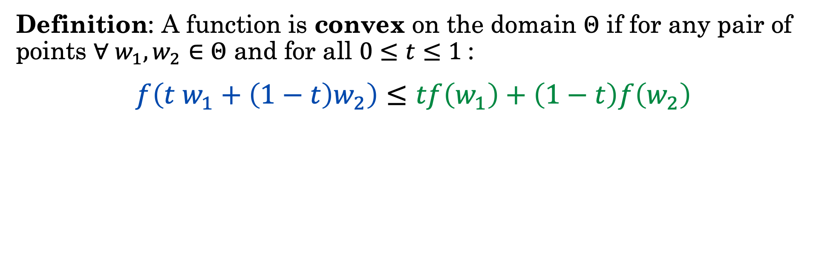

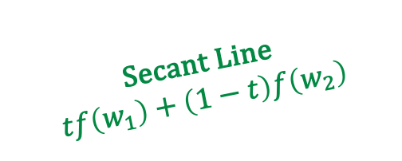
Convex Functions
Definition: A function is convex on the domain $Θ$ if for any pair of points $∀ w_{1},w_{2}∈Θ$ and for all $0≤t≤1$:
$$f\left(t w_{1}+\left(1−t\right)w_{2}\right)≤tf\left(w_{1}\right)+\left(1−t\right)f\left(w_{2}\right)$$
Secant Line
$$tf\left(w_{1}\right)+\left(1−t\right)f\left(w_{2}\right)$$
Convex:
Non-Convex:
$$f\left(t w_{1}+\left(1−t\right)w_{2}\right)$$
In general, there are efficient algorithms to reliably minimize convex functions.

Slide 9
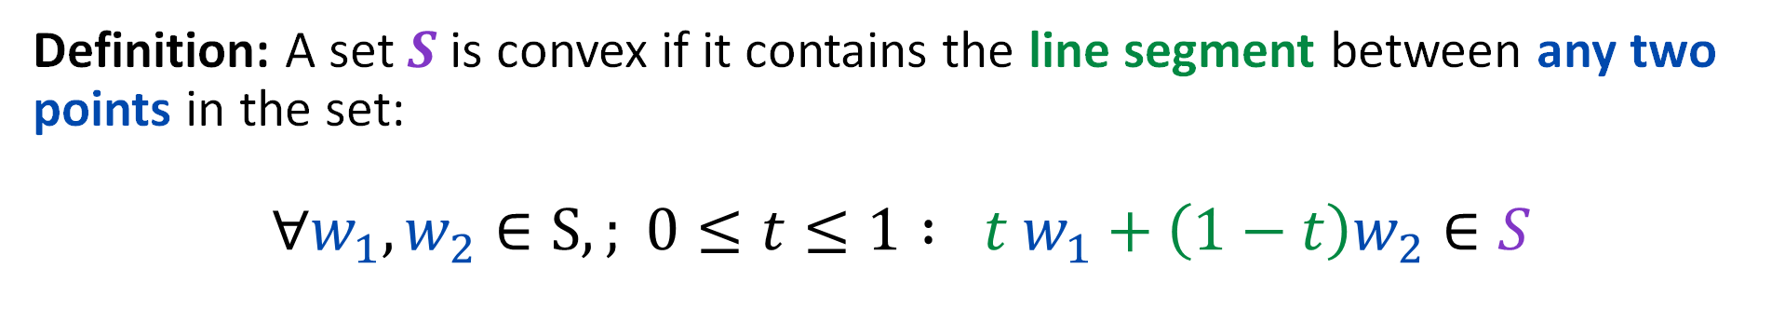
Convex (Constraint) Sets
Definition: A set $S$ is convex if it contains the line segment between any two points in the set:
$$∀w_{1}, w_{2}∈S,; 0≤t≤1 : t w_{1}+\left(1−t\right)w_{2}∈S$$
Convex Set
Non-convex Set
In general, there are efficient algorithms to reliably minimize convex functions over convex sets.

Slide 10
Optimization Problems
Optimization of a convex objective function over a convex constraint set.
ML problems that we can solve efficiently
Primary focus of EECS-127 and books
Many classic ML problems are convex.
Least Squares Regression and Logistic Regression
Most of modern ML (deep learning) is not convex.
We use convex optimization techniques for non-convex problems
In this class, introduce basic optimization concepts
Convex Function
Convex Constraints

Slide 11
Minimizing the Error & Optimizing in Weight-Space

Slide 12







Points on the Error Surface
$$E(w;D)$$
Each parameterization of a model corresponds to a point on the error surface $E(w;D)$.
Goal: find parameterization with lowest error: $w^{∗}=\underset{w∈ℝ^{d}}{arg min}{E(w;D)}$
$$w_{1}$$
$$w_{0}$$
Data
$$w_{1}$$
$$E(w;D)$$
Weight Space
$$w_{0}$$
Plots in demo notebook.

Slide 13
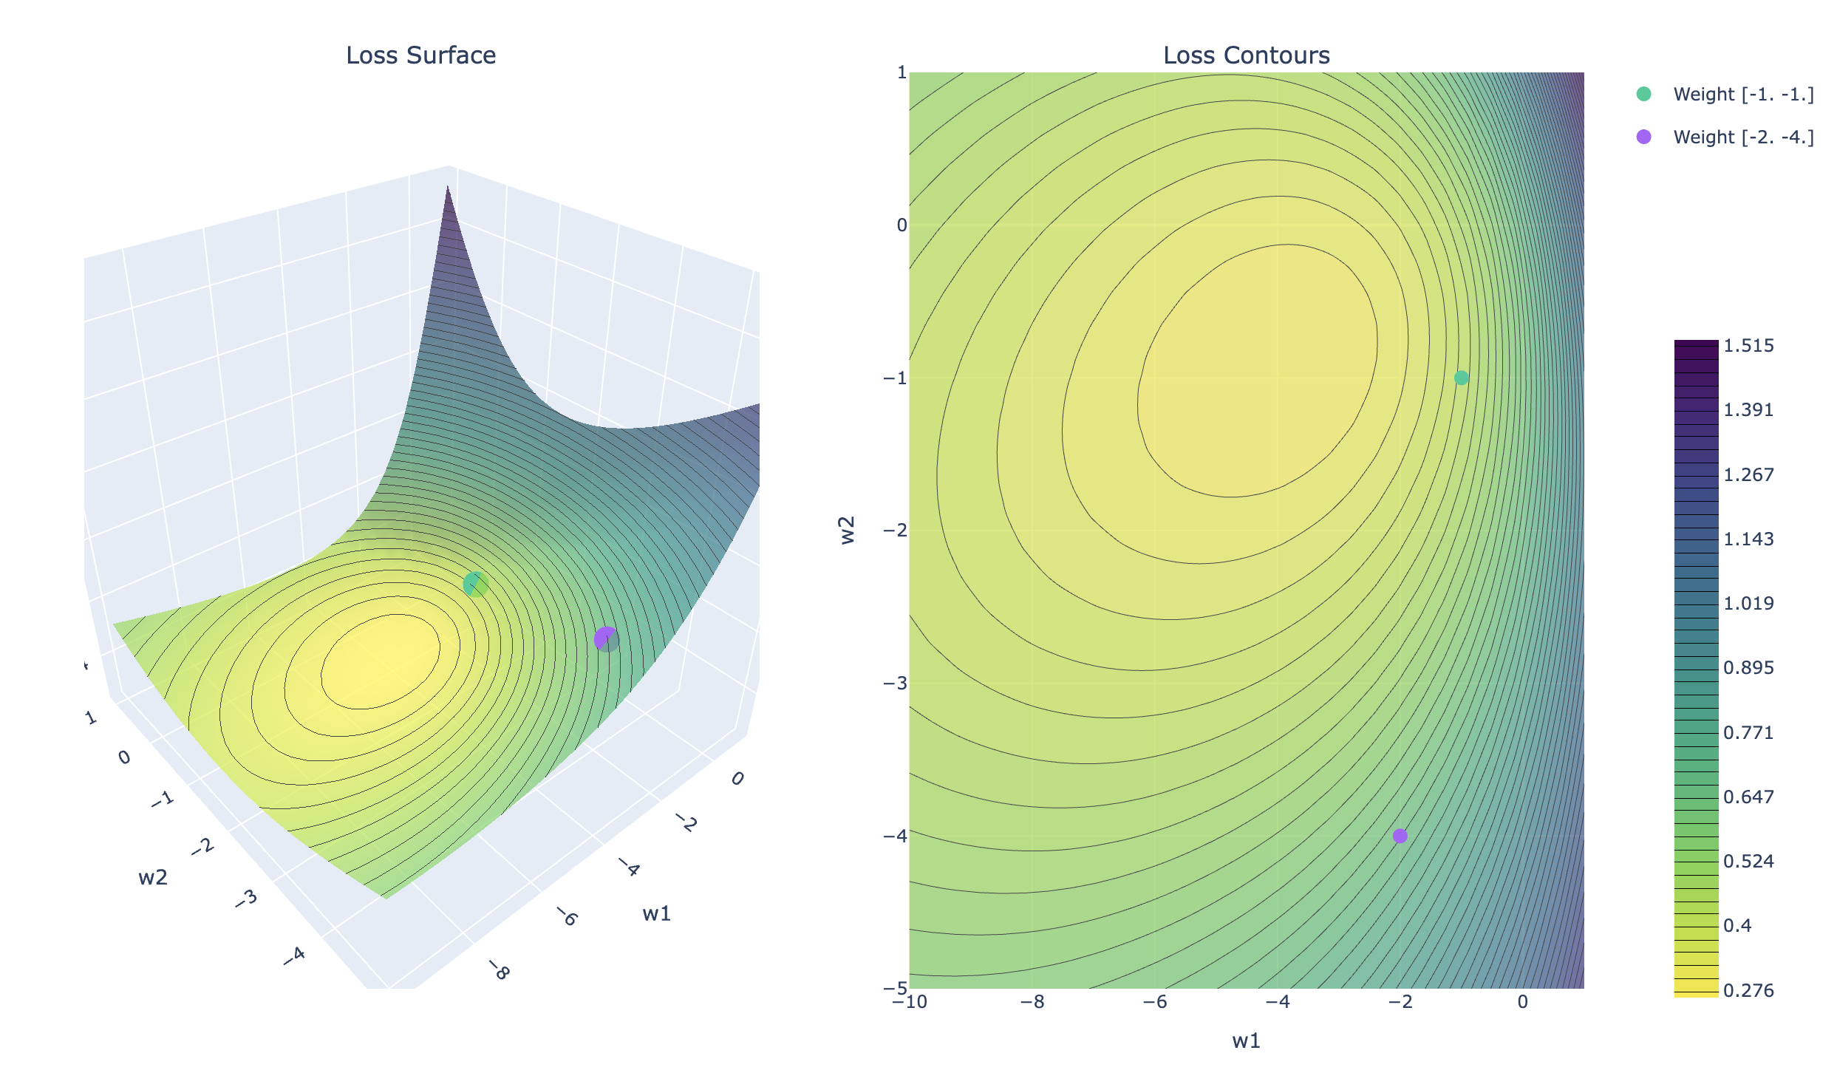
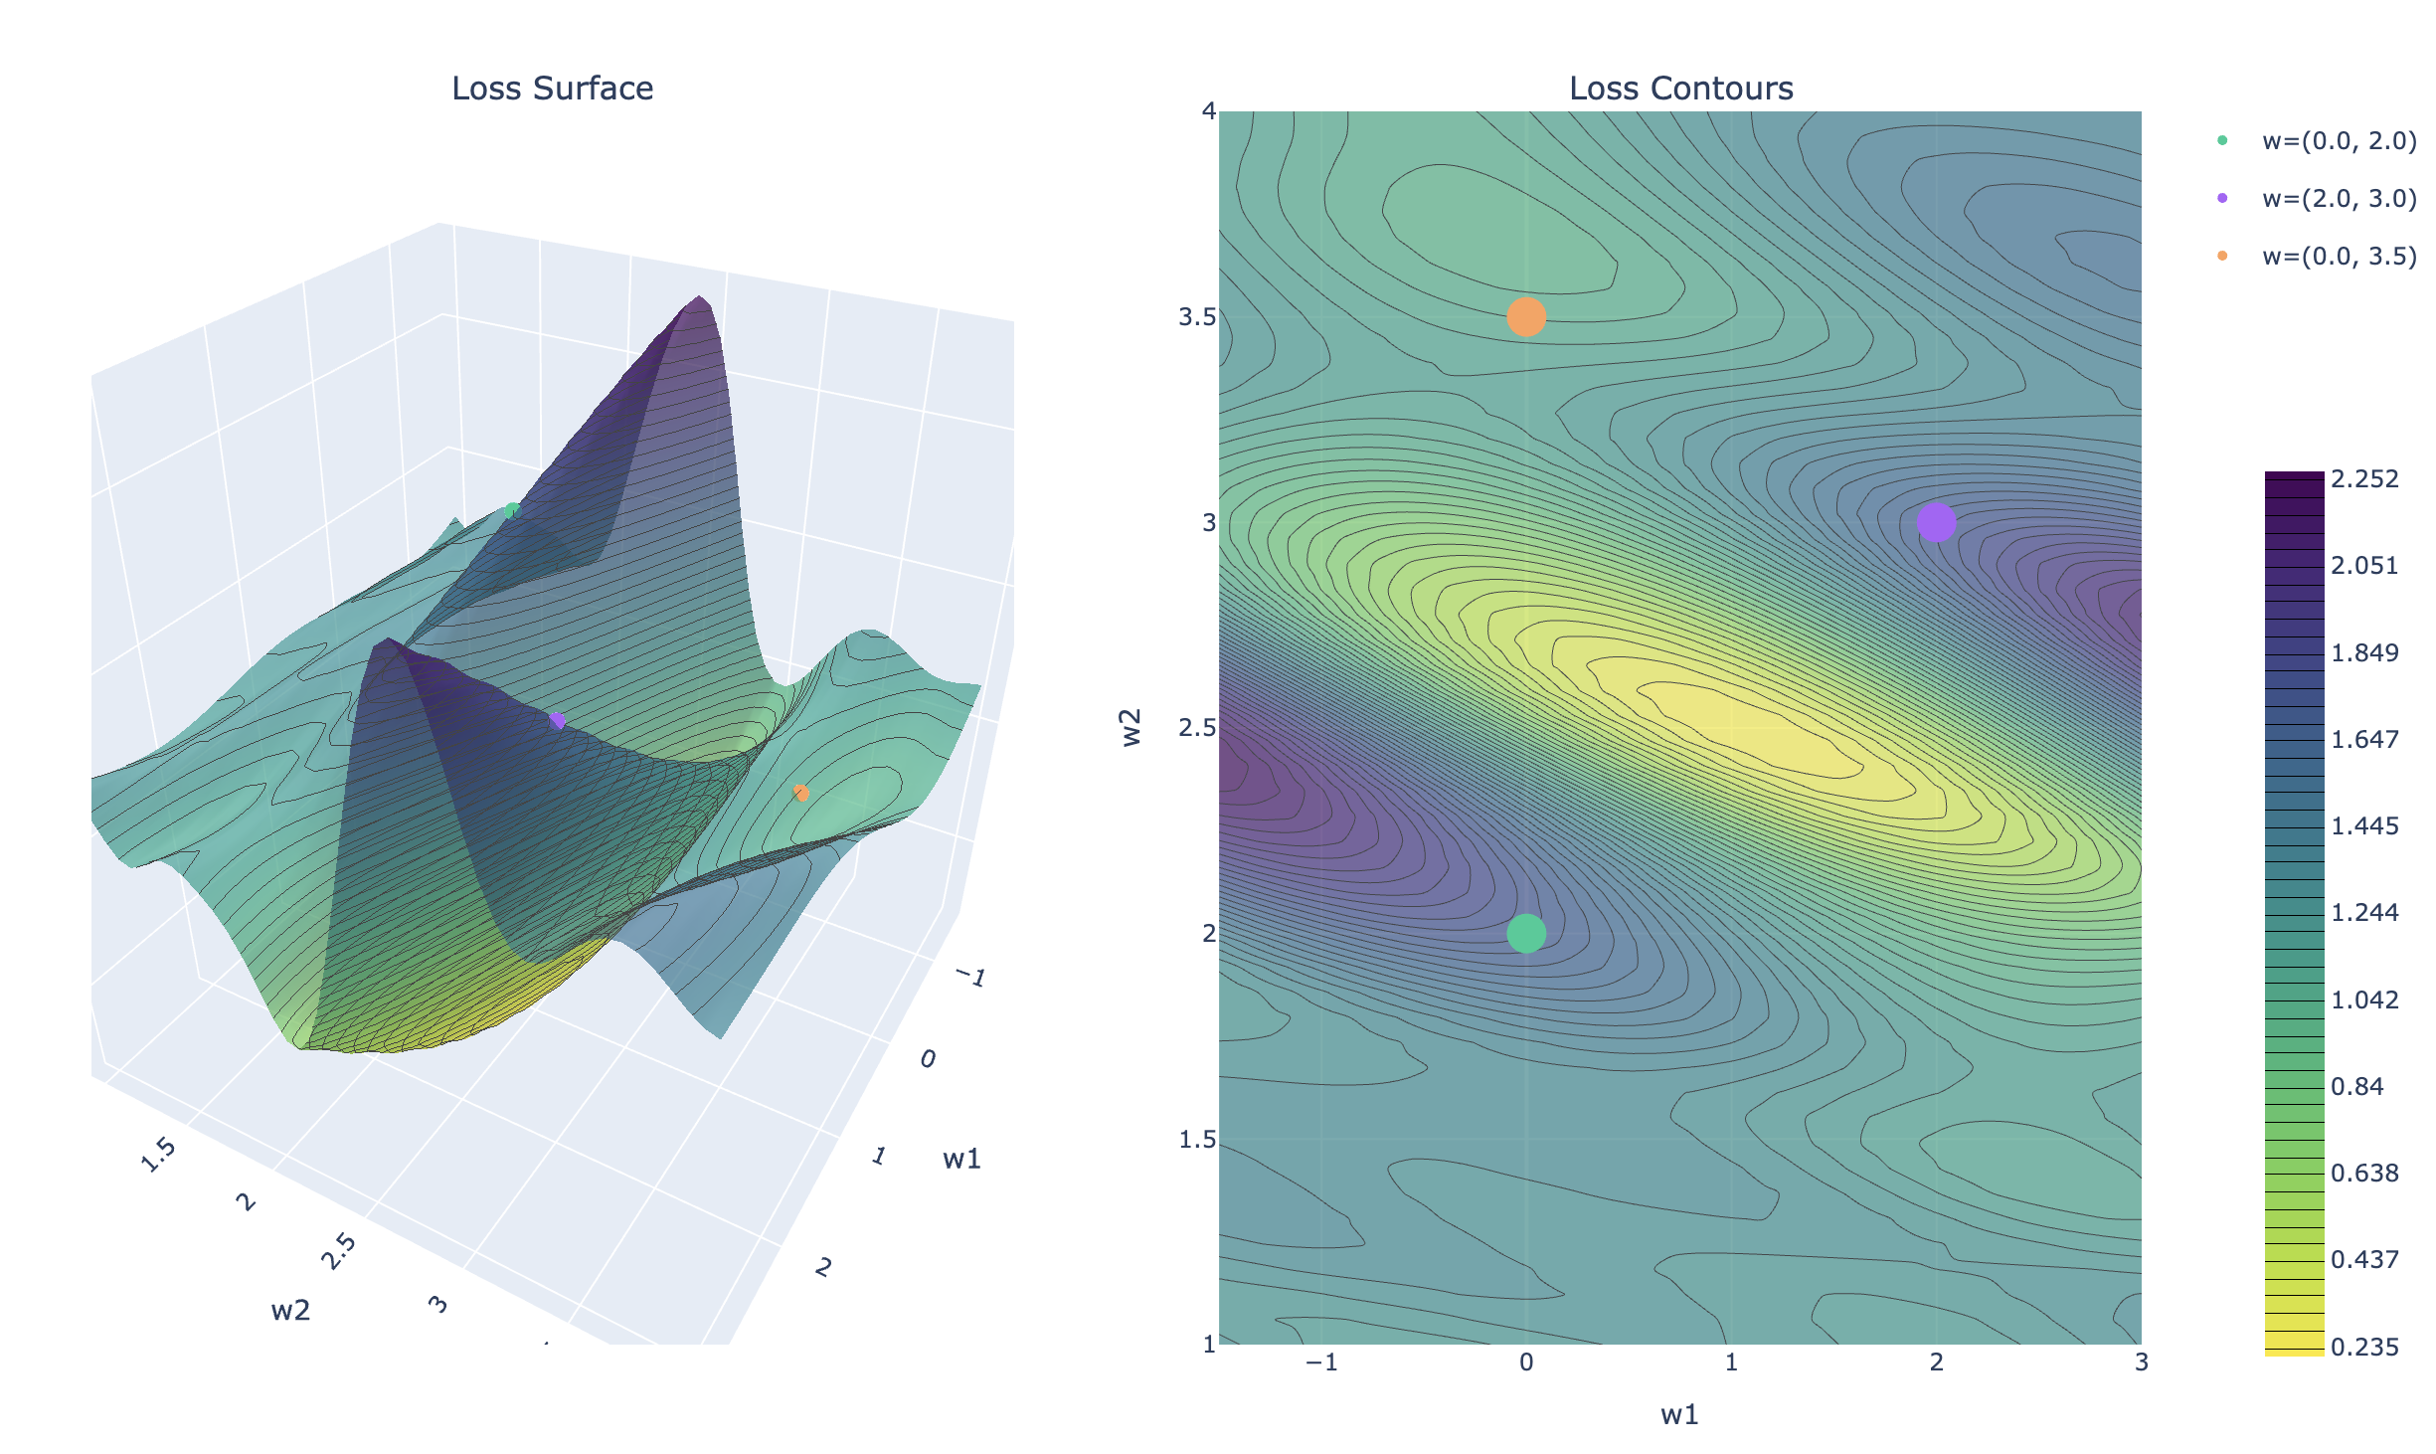
Demo
Understanding the Error Surface

Slide 14
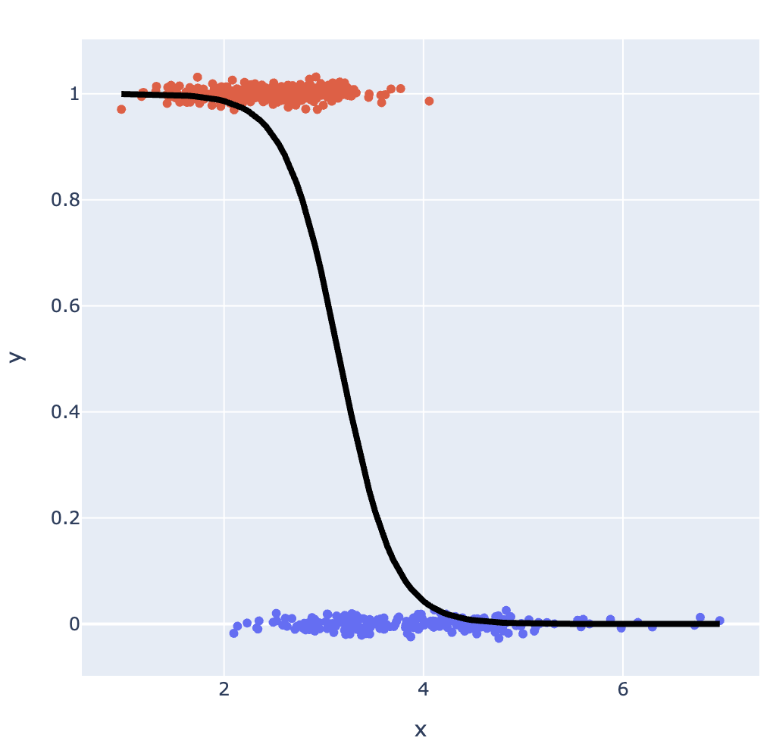
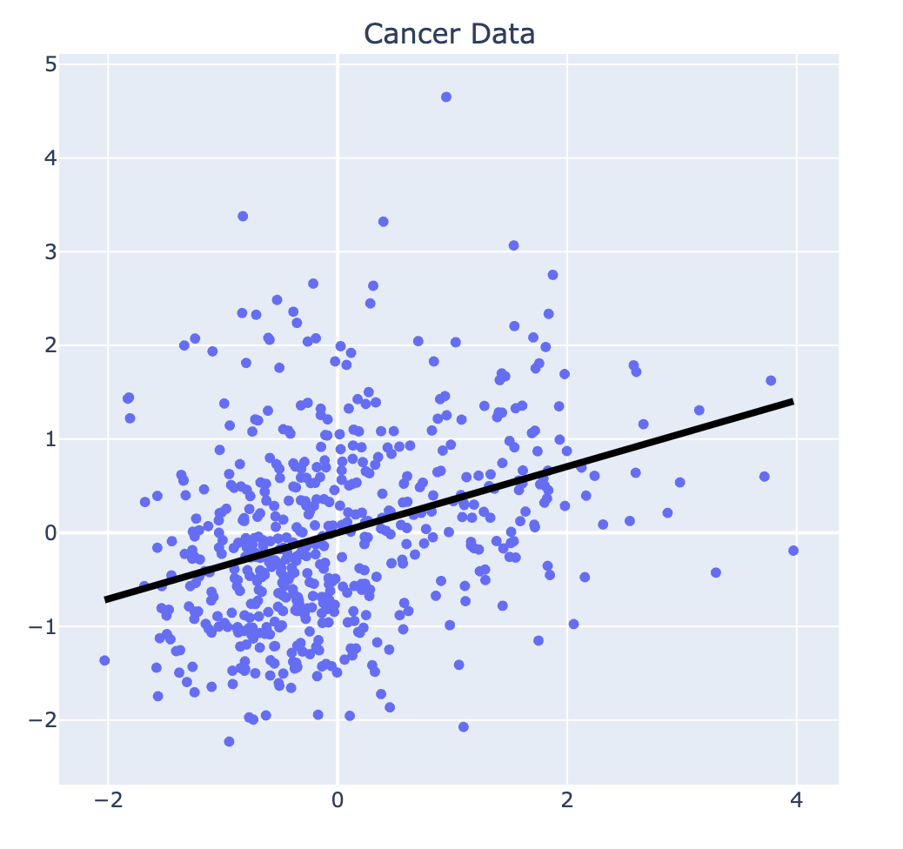
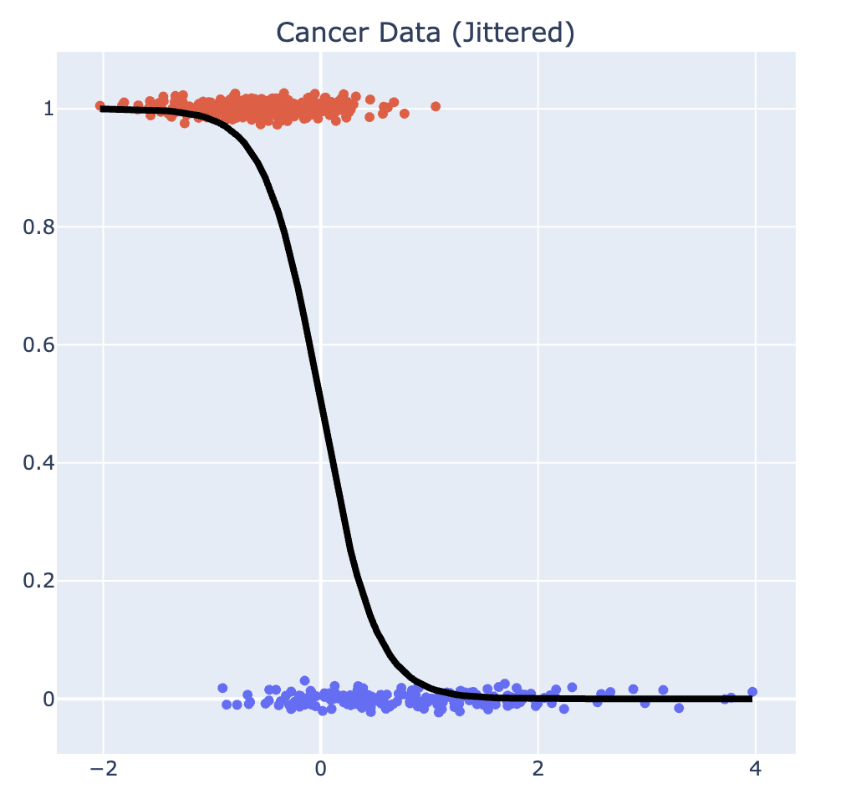
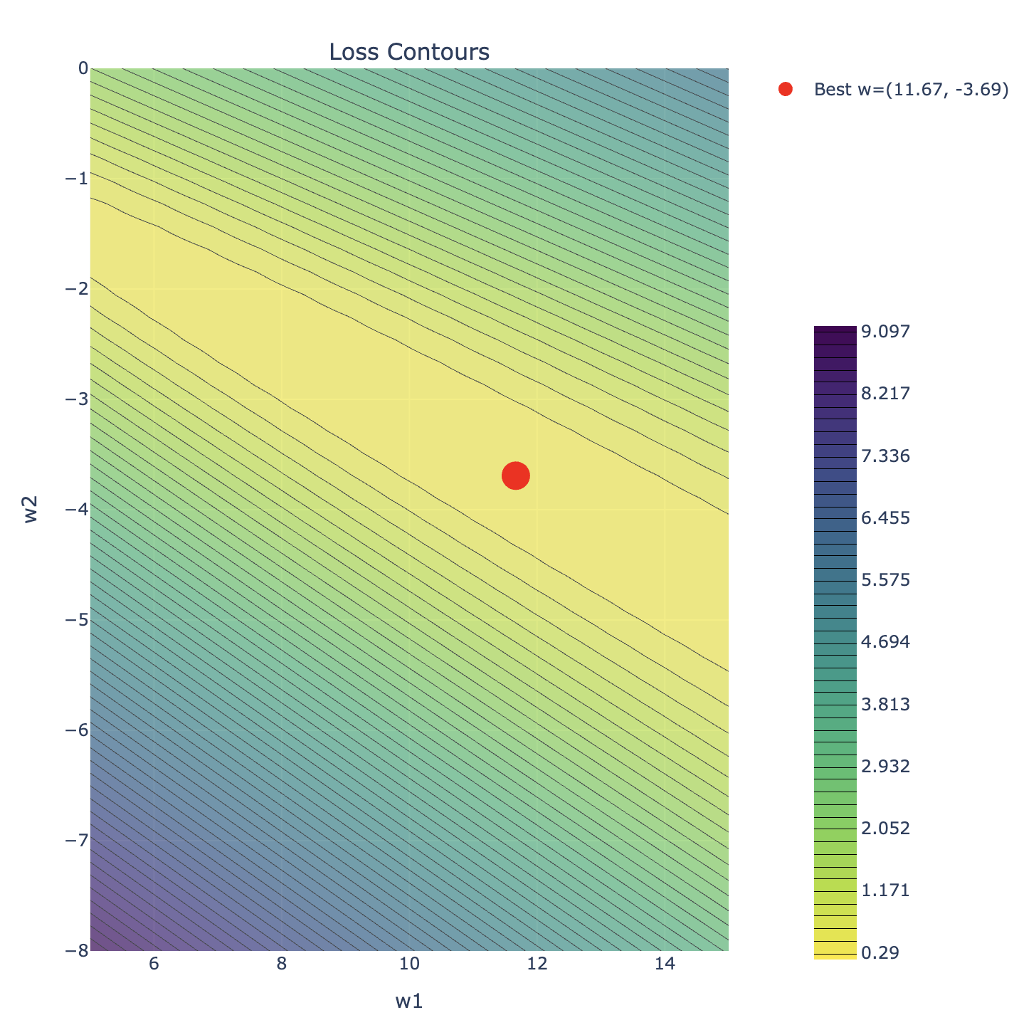
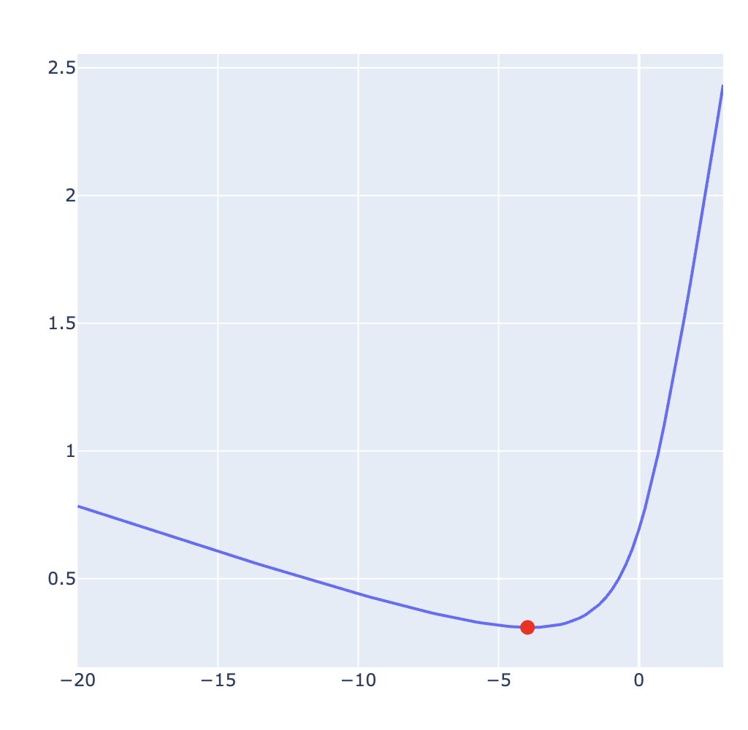
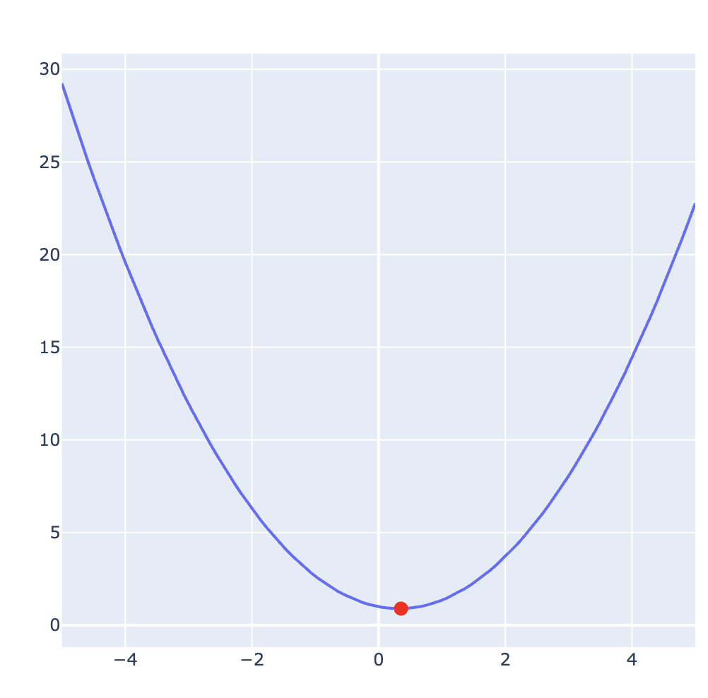
Slido Matching
Model 1
Logistic
Regression
Model 2
Least Squares
Regression
Model 3
Logistic
Regression
C
A
B

Slide 15



Do not edit How to change the design
Match the model with the loss.
The Slido app must be installed on every computer you’re presenting from

Slide 16
Calculus and Optimization

Slide 17

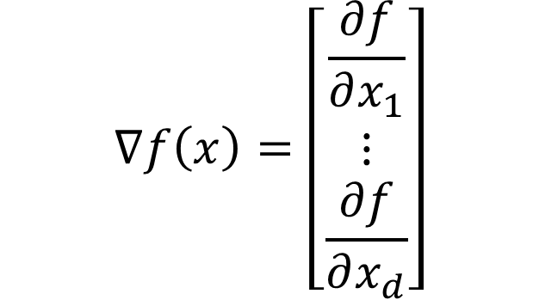
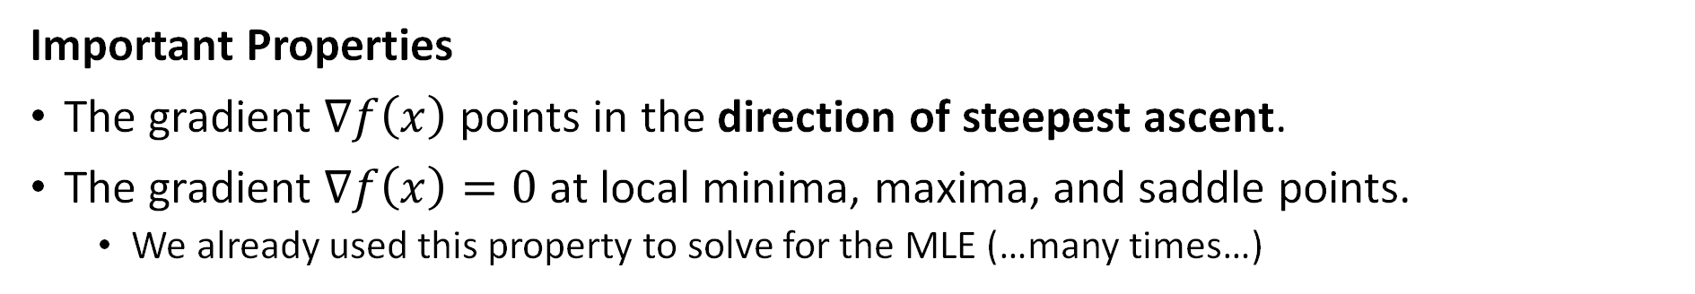
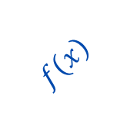
The Gradient
The gradient of a scalar-valued function $f:ℝ^{d}→ℝ$ is the column vector-valued function $∇f:ℝ^{d}→ℝ^{d}$ of partial derivatives of $f$
$$∇f\left(x\right)=\left[\begin{matrix}\frac{∂f}{∂x_{1}} \\ ⋮ \\ \frac{∂f}{∂x_{d}}\end{matrix}\right]$$
$$f\left(x\right)$$
$$∇f\left(x\right)$$
Important Properties
The gradient $∇f\left(x\right)$ points in the direction of steepest ascent.
The gradient $∇f\left(x\right)=0$ at local minima, maxima, and saddle points.
We already used this property to solve for the MLE (…many times…)

Slide 18

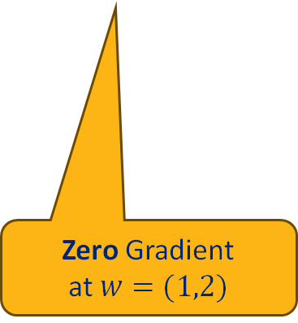



Gradient Exercise
Gradient
$$∇f\left(x\right)=\left[\begin{matrix}\frac{∂f}{∂x_{1}} \\ ⋮ \\ \frac{∂f}{∂x_{d}}\end{matrix}\right]$$
Consider the function:
$E(w)={\left(w_{0}−1\right)}^{2}+{\left(w_{1}−2\right)}^{2}+1$
Compute the partial derivatives:
$\frac{∂}{∂w_{0}}E\left(w\right)=$
$\frac{∂}{∂w_{1}}E\left(w\right)=$
Then the gradient is:
$$∇E\left(w\right)=\left[\begin{aligned}2(w_{0}−1) \\ 2(w_{1}−2)\end{aligned}\right]$$
Gradient
$$2(w_{0}−1)$$
$$2(w_{1}−2)$$
The gradient points in the direction of greatest ascent.
Zero Gradient at $w=(1,2)$
Plots in demo notebook.
1846379

Slide 19
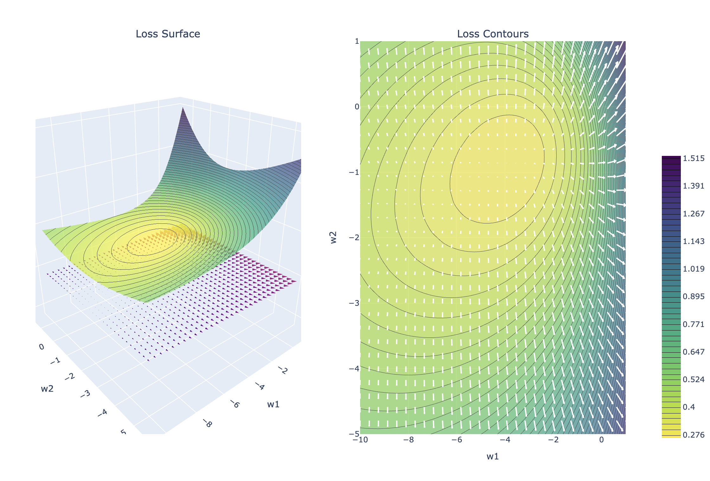
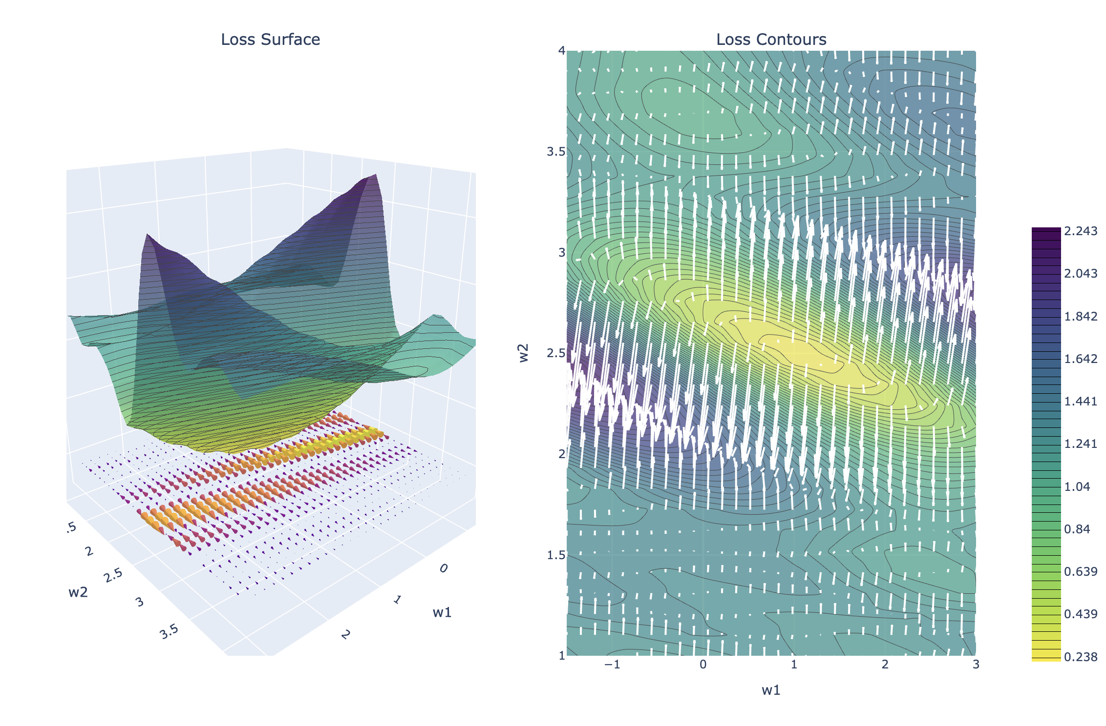
Demo
The Gradient of the Error Function

Slide 20

Do not edit How to change the design
If w is a d-dimensional vector and E(w) is a scalar-valued function, what is the dimensionality of the gradient ∇E(w) with respect to w?
The Slido app must be installed on every computer you’re presenting from

Slide 21


Common Confusion
1846379
$$E(w)={\left(w_{0}−1\right)}^{2}+{\left(w_{1}−2\right)}^{2}+1$$
The gradient does not lie on the surface of the function.
Example: $E:ℝ^{2}→ℝ$
The gradient $∇E:ℝ^{2}→ℝ^{2}$ is 2-dimensional (not 3)
Not the gradient!
The gradient is in the domain of the function.

Slide 22
Stationary Points and Zero Gradient
Anywhere the gradient is zero is a stationary point.
Gradient is zero at local minima but zero gradient does not imply a minima
$$E_{A}\left[w\right]={\left(w_{0}−1\right)}^{2}+{\left(w_{1}−2\right)}^{2}+1$$
$$E_{B}\left[w\right]={−\left(w_{0}−1\right)}^{2}−{\left(w_{1}−2\right)}^{2}+12$$
$$E_{C}\left[w\right]={−\left(w_{0}−1\right)}^{2}+{\left(w_{1}−2\right)}^{2}+1$$
Minimum
Maximum
Saddle Point
Plots in demo notebook.

Slide 23
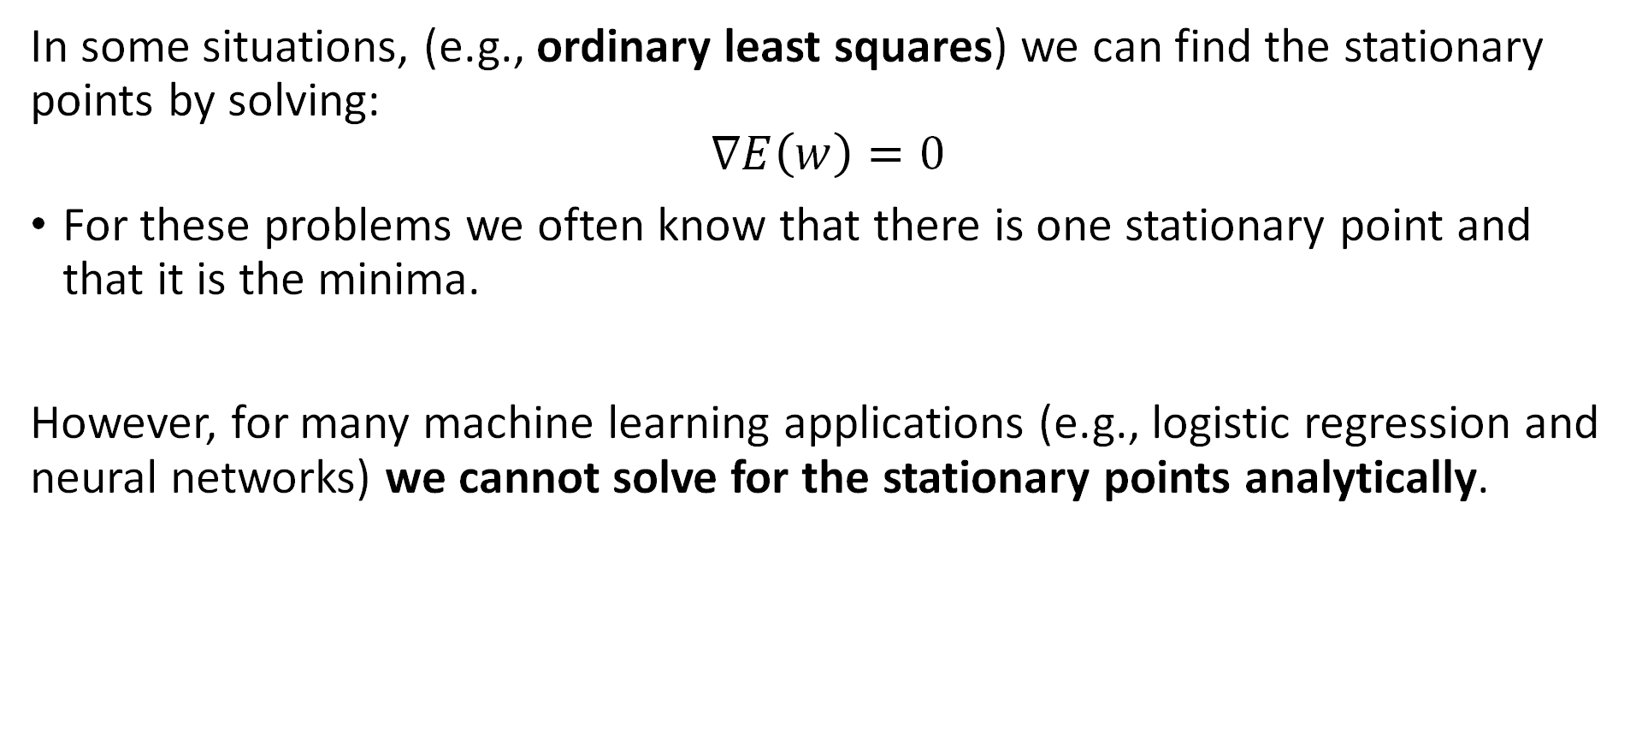
Analytical Optimization using Gradients
In some situations, (e.g., ordinary least squares) we can find the stationary points by solving:
$$∇E\left(w\right)=0$$
For these problems we often know that there is one stationary point and that it is the minima.
However, for many machine learning applications (e.g., logistic regression and neural networks) we cannot solve for the stationary points analytically.

Slide 24
Gradient Descent
Iterative optimization

Slide 25

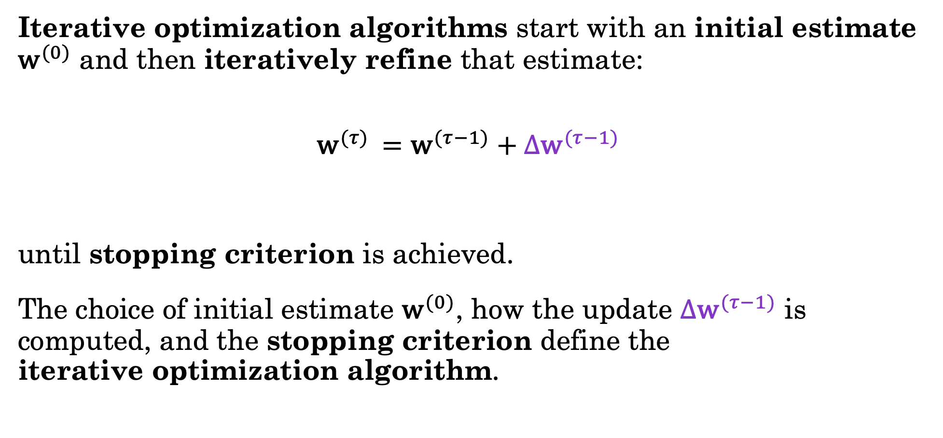
Iterative Optimization Algorithms
Iterative optimization algorithms start with an initial estimate ${\text{w}}^{(0)}$ and then iteratively refine that estimate:
$${\text{w}}^{(τ) }={\text{w}}^{(τ−1)}+{Δ\text{w}}^{(τ−1)}$$
until stopping criterion is achieved.
The choice of initial estimate ${\text{w}}^{(0)}$, how the update ${Δ\text{w}}^{(τ−1)}$ is computed, and the stopping criterion define the iterative optimization algorithm.
Iteration $τ$
New Estimate
Old Estimate
Update
(Based on Gradient)

Slide 26



Intuition
Error
$$w_{0}$$
$$w_{1}$$
$$w_{2}$$
Goal: Minimize the loss by turning the knobs.
Try the loss game (its free)!

Slide 27
Intuition
Error
$$w_{0}$$
$$w_{1}$$
$$w_{2}$$
Try the loss game (its free)!

Slide 28
Intuition
Error
$$w_{0}$$
$$w_{1}$$
$$w_{2}$$
Try the loss game (its free)!

Slide 29
Intuition
Error
$$w_{0}$$
$$w_{1}$$
$$w_{2}$$
Try the loss game (its free)!

Slide 30
Intuition
Error
$$w_{0}$$
$$w_{1}$$
$$w_{2}$$
Try the loss game (its free)!

Slide 31
Intuition
Error
$$w_{0}$$
$$w_{1}$$
$$w_{2}$$
What if we knew which way to turn the knob and an idea of how far?
This is the Gradient!
Try the loss game (its free)!

Slide 32
Intuition
Error
$$w_{0}$$
$$w_{1}$$
$$w_{2}$$
Try the loss game (its free)!

Slide 33
Intuition
Error
$$w_{0}$$
$$w_{1}$$
$$w_{2}$$
Try the loss game (its free)!

Slide 34
Intuition
Error
$$w_{0}$$
$$w_{1}$$
$$w_{2}$$
Try the loss game (its free)!

Slide 35
Intuition
Error
$$w_{0}$$
$$w_{1}$$
$$w_{2}$$
Try the loss game (its free)!

Slide 36
Intuition
Error
$$w_{0}$$
$$w_{1}$$
$$w_{2}$$
This is Gradient descent!
Try the loss game (its free)!

Slide 37
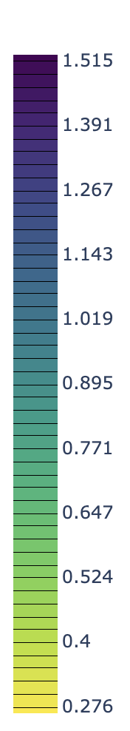
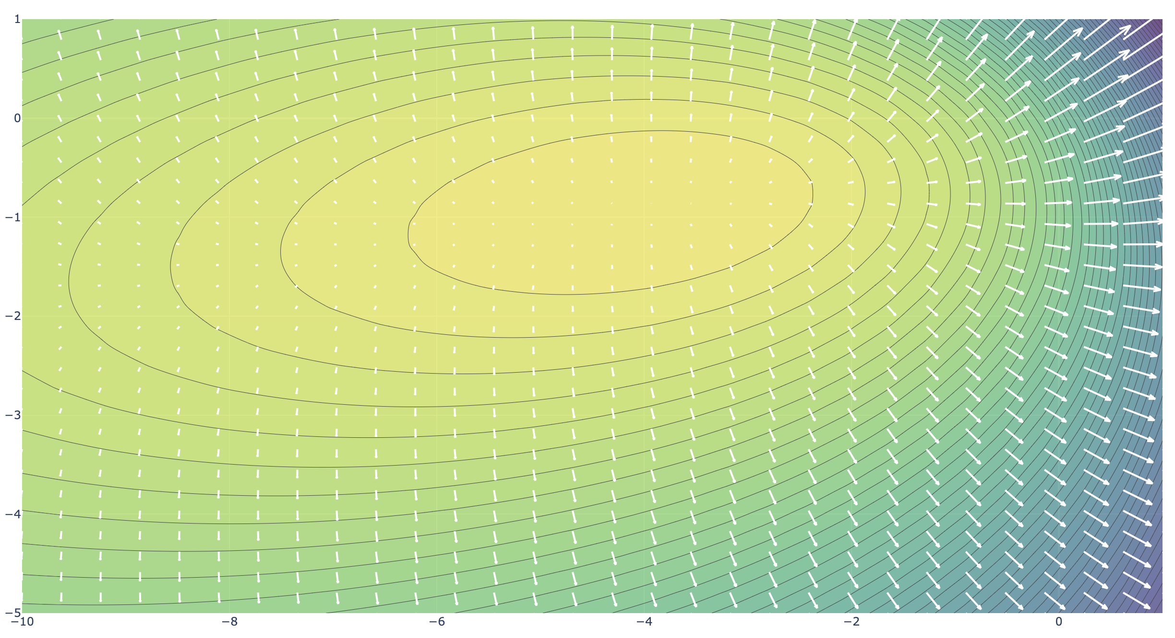




Gradient Descent Intuition
Error
1846379
Goal:
$$w^{∗}$$
$$w_{2}$$
Initial estimate:
Often a random guess
$${\text{w}}^{(0)}$$
$$w_{1}$$

Slide 38



Gradient Descent Intuition
Error
1846379
In high dimensional problems we can’t plot the error surface.
Why?
Difficult to visualize ☺
Expensive! How Expensive?
Grid resolution of $K$
Weight dimension $D$
Requires $𝓞\left(K^{D}\right)$ error evaluations!
Loss
Evaluations
$$w_{2}$$
$$K=6$$
$$D=2$$
Initial estimate:
Often a random guess
$${\text{w}}^{(0)}$$
$$w_{1}$$

Slide 39
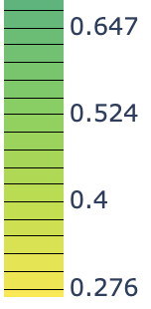



Gradient Descent Intuition
Error
1846379
Start with an initial estimate ${\text{w}}^{(0)}$ and then iteratively refine.
At each estimate ${\text{w}}^{(τ)}$ we can compute
The error – a scalar
How good is the current estimate
Doesn’t say which way to go…
The gradient – a vector
Which direction increases error
Go the opposite direction
Error
$$w_{2}$$
Error
$${\text{w}}^{(2)}$$
Error
$${\text{w}}^{(1)}$$
Gradient
$${\text{w}}^{(0)}$$
Gradient
$$w_{1}$$

Slide 40
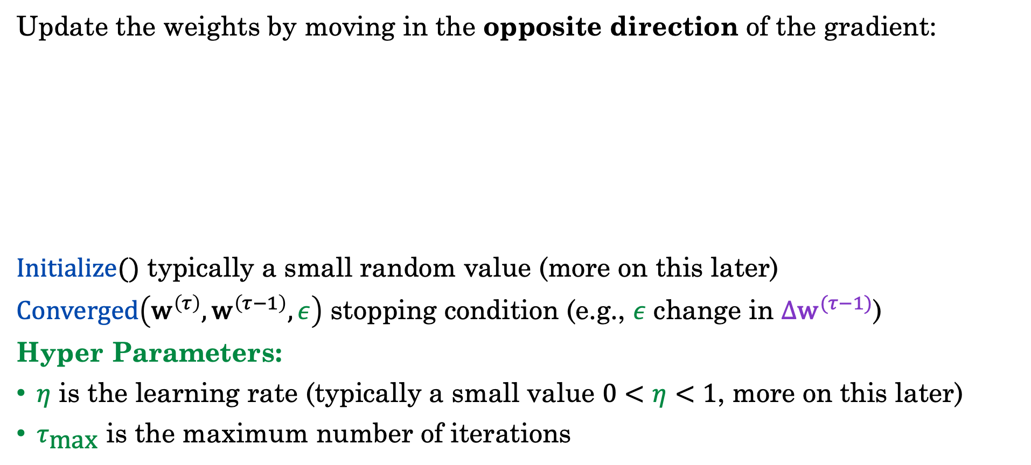
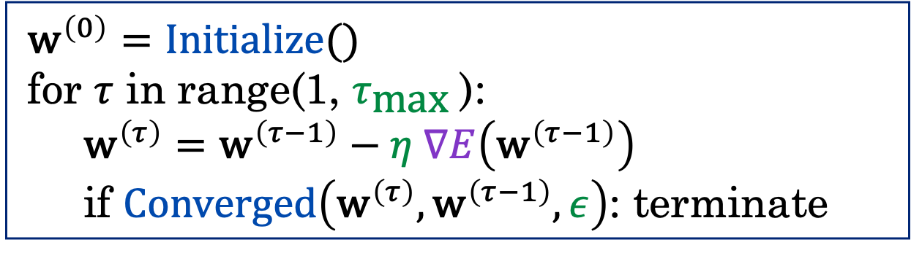
The (Batch) Gradient Descent Alg.
Update the weights by moving in the opposite direction of the gradient:
$Initialize()$ typically a small random value (more on this later)
$Converged\left({\text{w}}^{\left(τ\right)},{\text{w}}^{\left(τ−1\right)},ε\right)$ stopping condition (e.g., $ε$ change in ${Δ\text{w}}^{(τ−1)}$)
Hyper Parameters:
$η$ is the learning rate (typically a small value $0<η<1$, more on this later)
$τ_{\text{max}}$ is the maximum number of iterations
$${\text{w}}^{\left(0\right)}=Initialize()$$
for $τ$ in range(1, $τ_{\text{max}}$):
$${\text{w}}^{\left(τ\right)}={\text{w}}^{\left(τ−1\right)}−η ∇E\left({\text{w}}^{\left(τ−1\right)}\right)$$
if $Converged\left({\text{w}}^{\left(τ\right)},{\text{w}}^{\left(τ−1\right)}, ε\right)$: terminate
Notes:
Add tau max

Slide 41
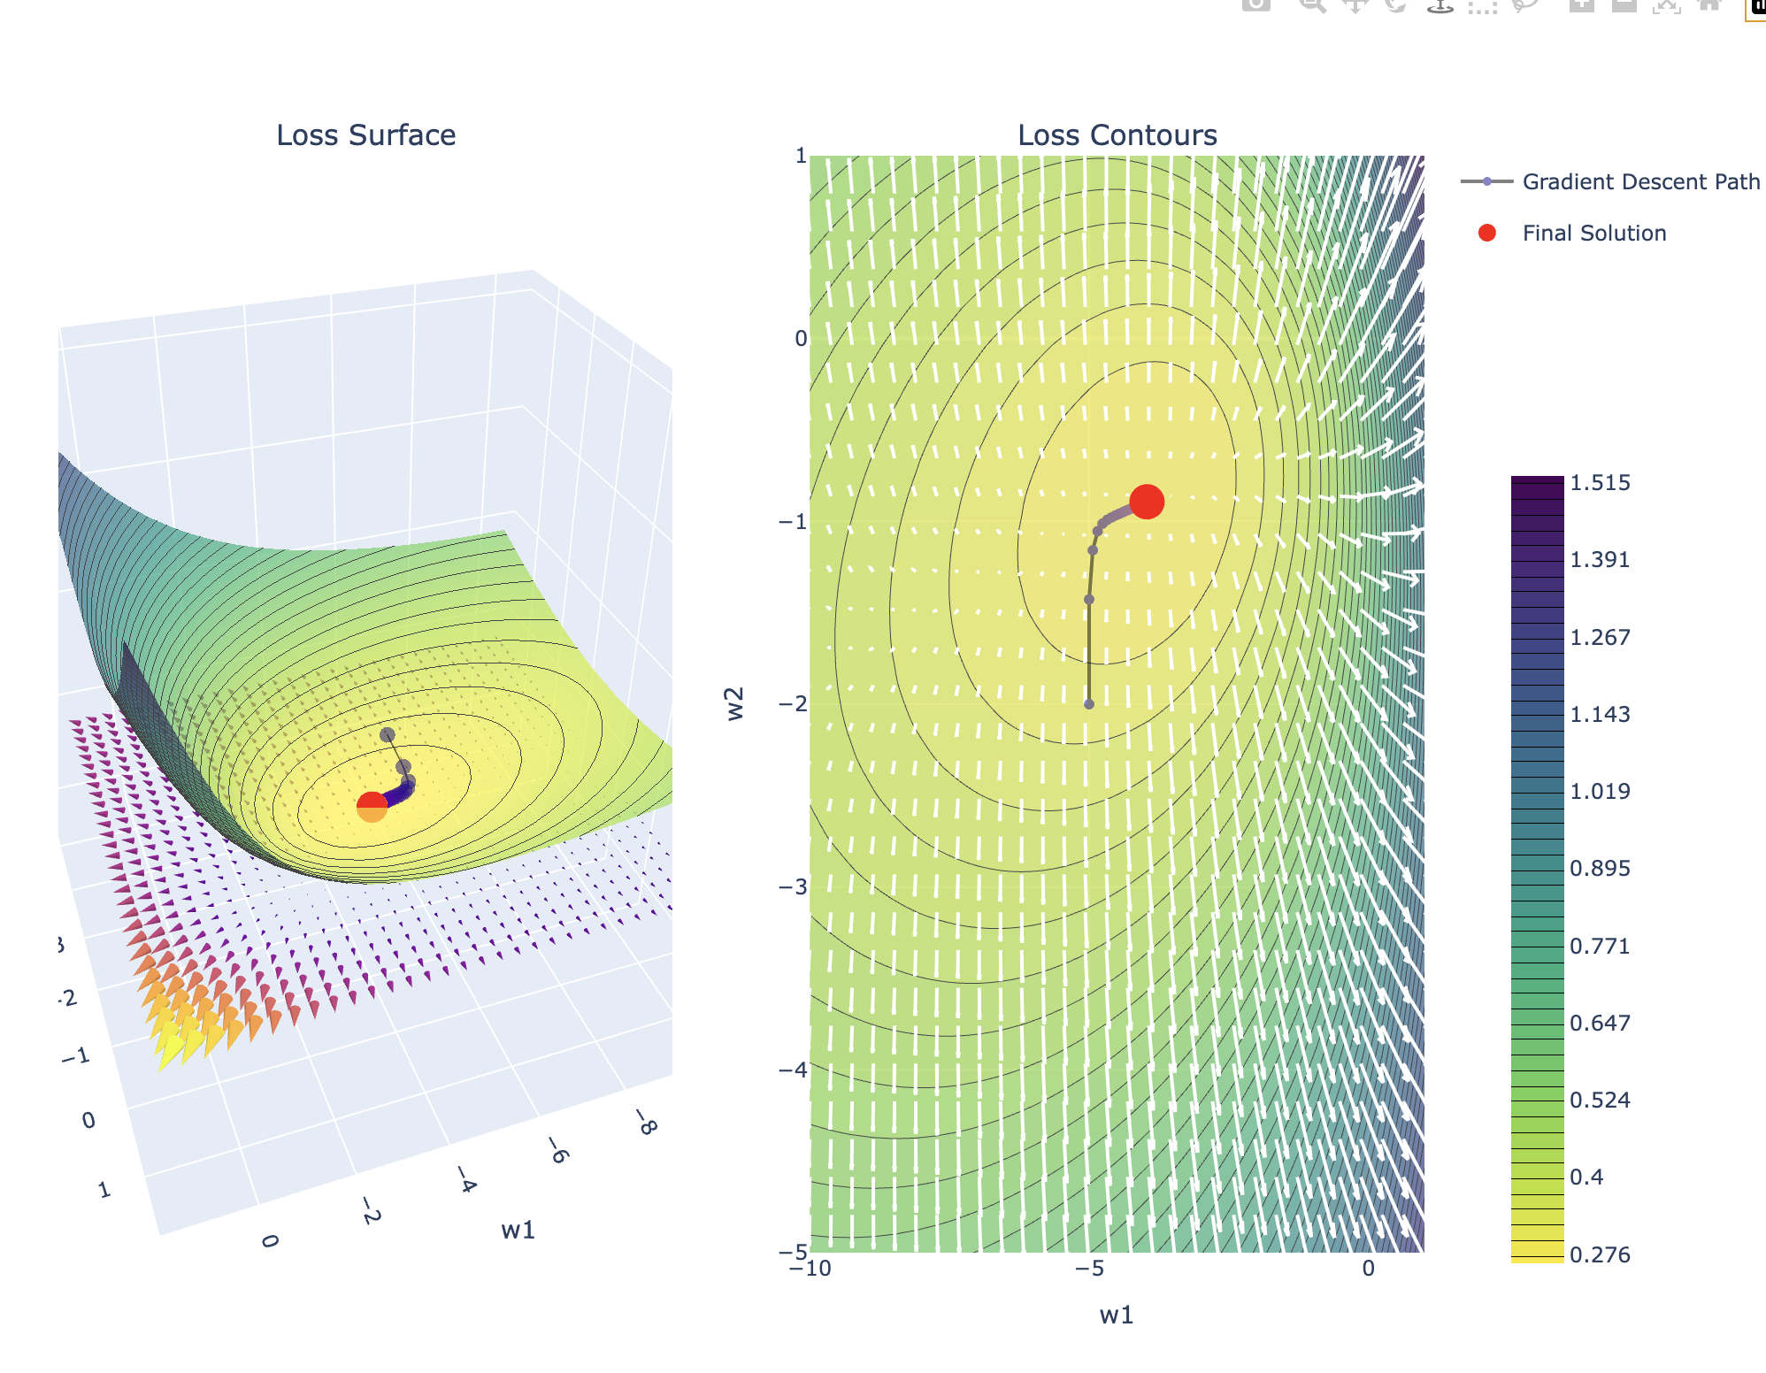
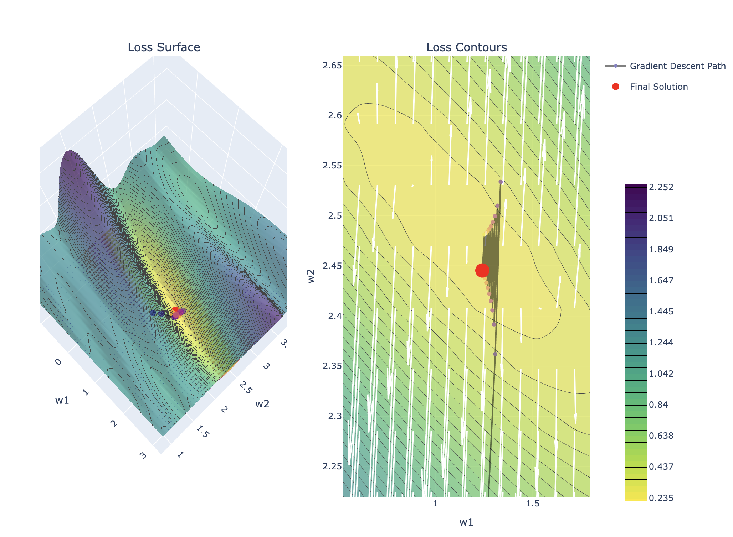
Demo
Batch Gradient Descent

Slide 42
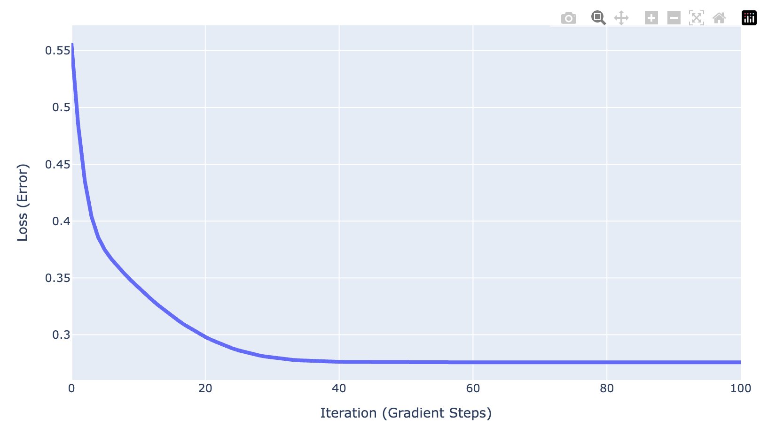
Loss (Error) Curves
The loss or error curve plots the error as a function of the number of iterations (steps) of gradient descent.
Training and Validation Error
Overfitting
Validation curves are typically above the training curves.
You can overoptimize the objective (overfit).
Choose parameters with lowest validation error.
Best Model
Validation Error
Training Error

Slide 43
Convergence Assuming Quadratic Approximation

Slide 44
Do not edit How to change the design
Assuming a simple quadratic equation (e.g., x^2) is gradient descent guaranteed to converge?
The Slido app must be installed on every computer you’re presenting from

Slide 45
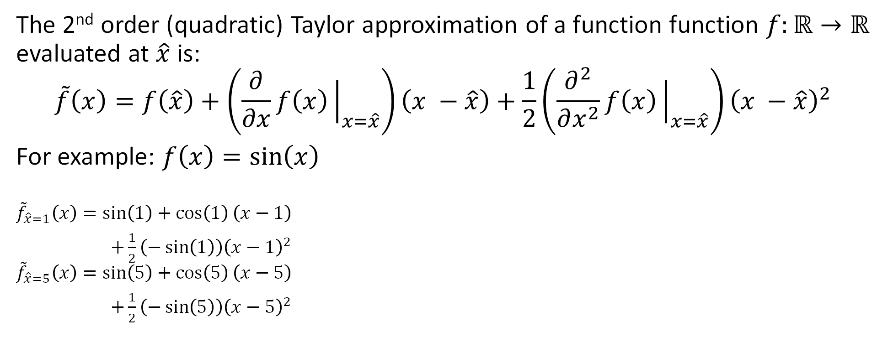
Quadratic Approximations
The 2nd order (quadratic) Taylor approximation of a function function $f:ℝ→ℝ$ evaluated at $\hat{x}$ is:
$$\tilde{f}\left(x\right)=f\left(\hat{x}\right)+\left(\frac{∂}{∂x}f\left(x\right){\left.​\right|}_{x=\hat{x}}\right)\left(x −\hat{x}\right)+\frac{1}{2}\left(\frac{∂^{2}}{∂x^{2}}f\left(x\right){\left.​\right|}_{x=\hat{x}}\right){\left(x −\hat{x}\right)}^{2}$$
For example: $f\left(x\right)=sin\left(x\right)$
$${\tilde{f}}_{\hat{x}=1}\left(x\right)=\sin\left(1\right)+\cos\left(1\right)\left(x−1\right)$$
$+\frac{1}{2}\left(−\sin\left(1\right)\right){\left(x−1\right)}^{2}$
$${\tilde{f}}_{\hat{x}=5}\left(x\right)=\sin\left(5\right)+\cos\left(5\right)\left(x−5\right)$$
$+\frac{1}{2}\left(−\sin\left(5\right)\right){\left(x−5\right)}^{2}$

Slide 46

Taylor Expansion of the Error Surface
The 2nd-order Taylor expansion of the error surface at $\hat{w}$:
$${\tilde{E}}_{\hat{w}}\left(w\right)=E\left(\hat{w}\right)+{\left(w−\hat{w}\right)}^{T}b+\frac{1}{2}{\left(w−\hat{w}\right)}^{T} H \left(w−\hat{w}\right)$$
$b=∇E\left(\hat{w}\right)$is the Gradient of E evaluated at $\hat{w}$ (vector)
$H=∇∇E\left(\hat{w}\right)$ is the Hessian of E evaluated at $\hat{w}$ (a matrix)
Matrix Equivalent of the Second Derivative

Slide 47
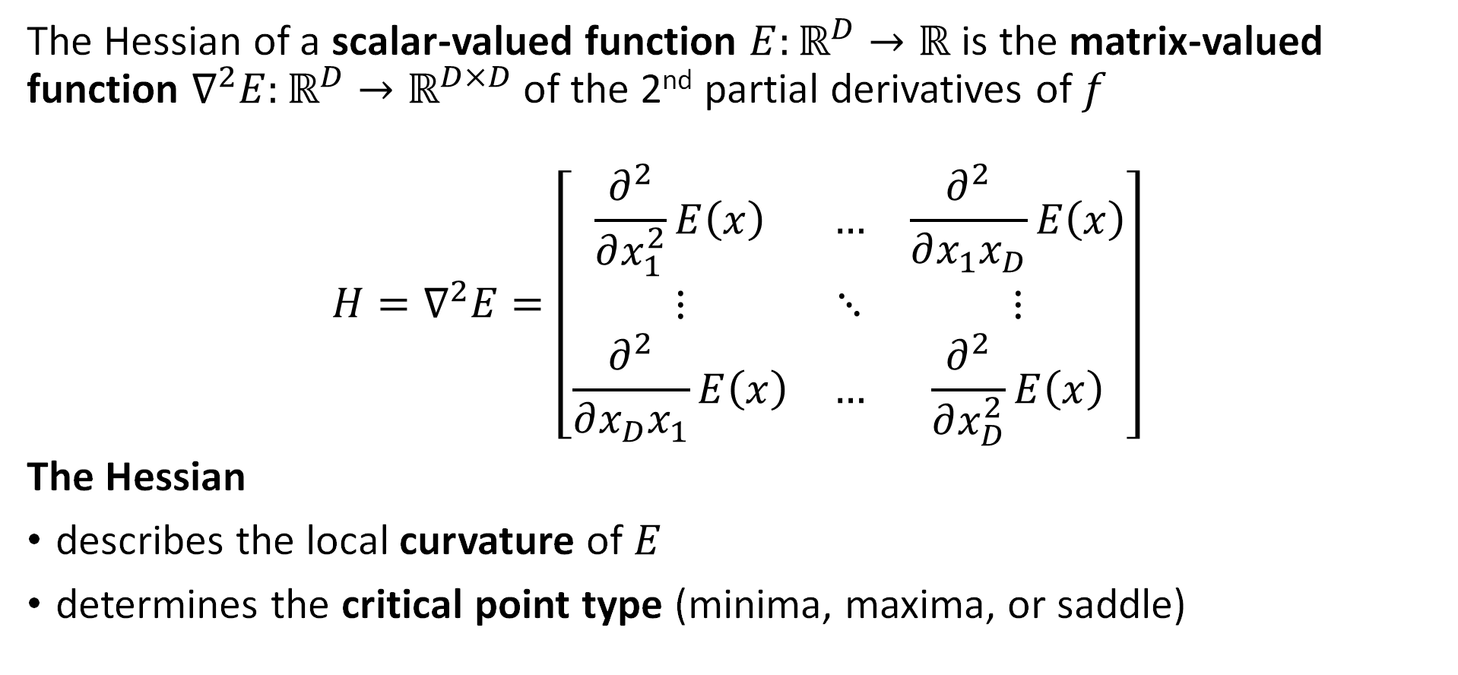
Hessians (the 2nd derivative)
The Hessian of a scalar-valued function $E:ℝ^{D}→ℝ$ is the matrix-valued function $∇^{2}E:ℝ^{D}→ℝ^{D×D}$ of the 2nd partial derivatives of $f$
$$H=∇^{2}E=\left[\begin{matrix}\frac{∂^{2}}{∂x_{1}^{2}}E\left(x\right) & … & \frac{∂^{2}}{∂x_{1}x_{D}}E\left(x\right) \\ ⋮ & ⋱ & ⋮ \\ \frac{∂^{2}}{∂x_{D}x_{1}}E\left(x\right) & … & \frac{∂^{2}}{∂x_{D}^{2}}E\left(x\right)\end{matrix}\right]$$
The Hessian
describes the local curvature of $E$
determines the critical point type (minima, maxima, or saddle)

Slide 48
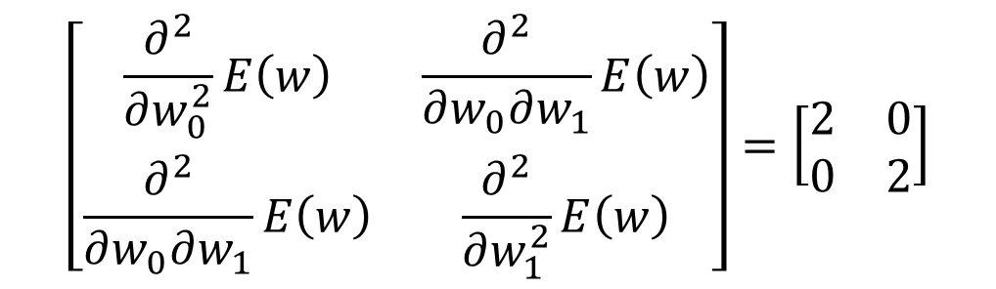
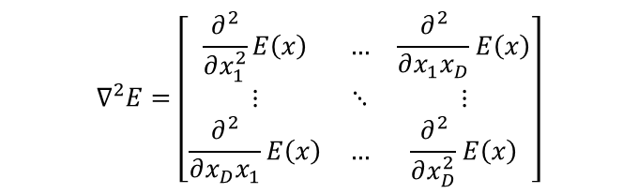


Hessian Exercise
1846379
Consider the function:
$E(w)={\left(w_{0}−1\right)}^{2}+{\left(w_{1}−2\right)}^{2}+1$
Then the gradient is: $∇E\left(w\right)=\left[\begin{aligned}2(w_{0}−1) \\ 2(w_{1}−2)\end{aligned}\right]$
The Hessian is:
$$\left[\begin{matrix}\frac{∂^{2}}{∂w_{0}^{2}}E\left(w\right) & \frac{∂^{2}}{∂w_{0}∂w_{1}}E\left(w\right) \\ \frac{∂^{2}}{∂w_{0}∂w_{1}}E\left(w\right) & \frac{∂^{2}}{∂w_{1}^{2}}E\left(w\right)\end{matrix}\right]=\left[\begin{matrix}2 & 0 \\ 0 & 2\end{matrix}\right]$$
$$H\left(w\right)=$$
Hessian
$$∇^{2}E=\left[\begin{matrix}\frac{∂^{2}}{∂x_{1}^{2}}E\left(x\right) & … & \frac{∂^{2}}{∂x_{1}x_{D}}E\left(x\right) \\ ⋮ & ⋱ & ⋮ \\ \frac{∂^{2}}{∂x_{D}x_{1}}E\left(x\right) & … & \frac{∂^{2}}{∂x_{D}^{2}}E\left(x\right)\end{matrix}\right]$$
Plots in demo notebook.

Slide 49
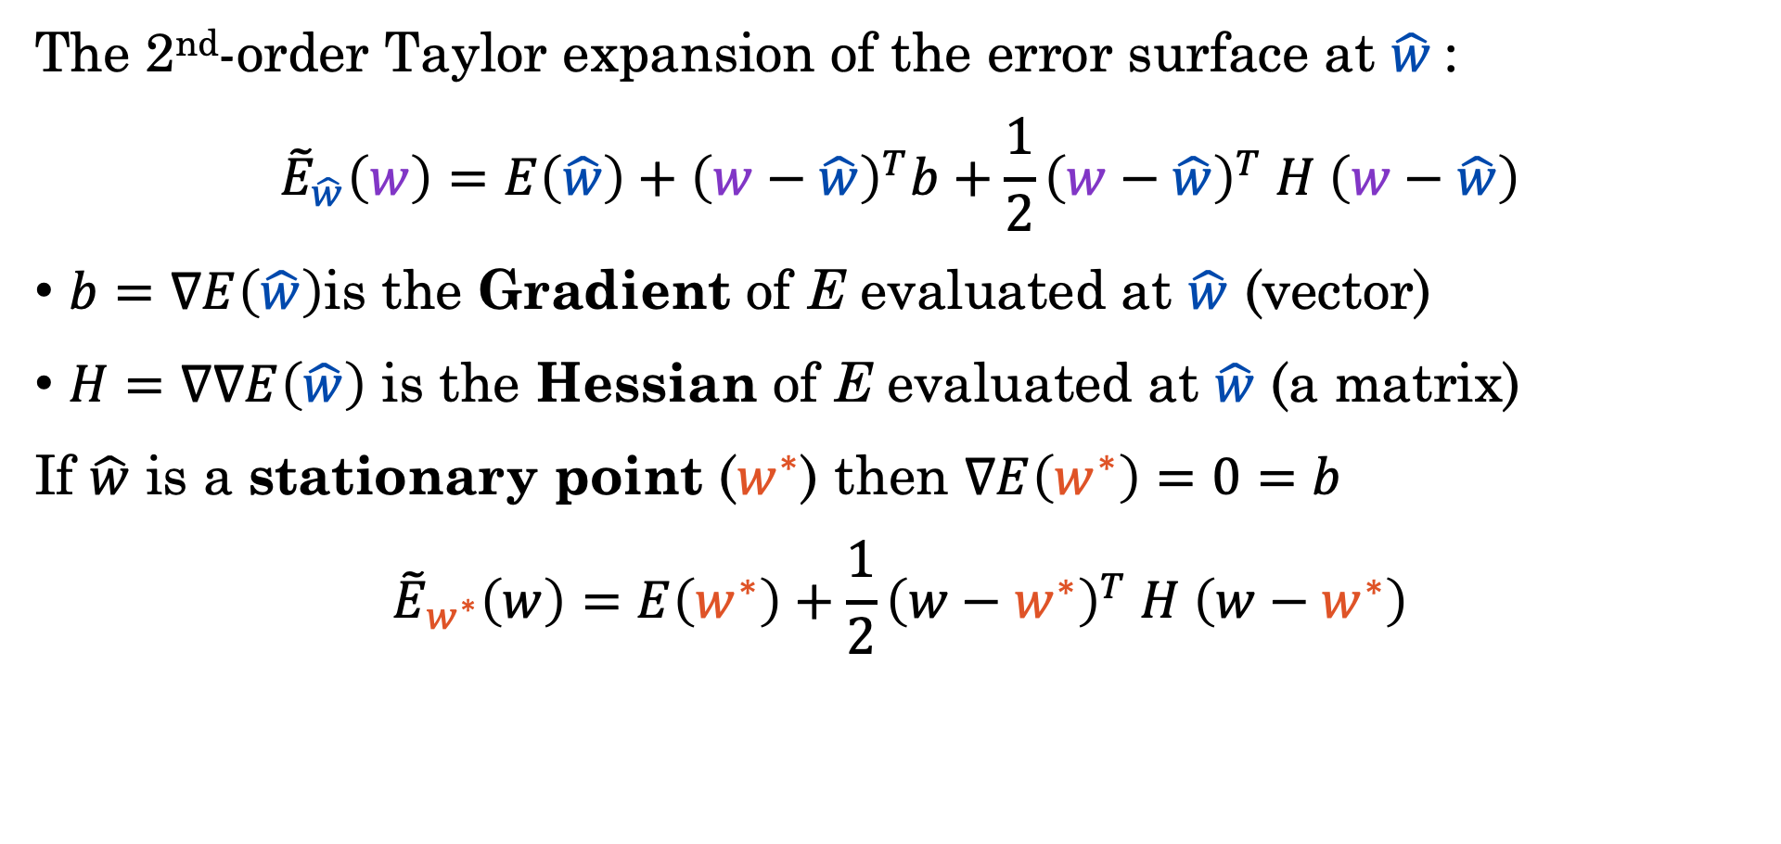
Taylor Expansion of the Error Surface
The 2nd-order Taylor expansion of the error surface at $\hat{w}$:
$${\tilde{E}}_{\hat{w}}\left(w\right)=E\left(\hat{w}\right)+{\left(w−\hat{w}\right)}^{T}b+\frac{1}{2}{\left(w−\hat{w}\right)}^{T} H \left(w−\hat{w}\right)$$
$b=∇E\left(\hat{w}\right)$is the Gradient of E evaluated at $\hat{w}$ (vector)
$H=∇∇E\left(\hat{w}\right)$ is the Hessian of E evaluated at $\hat{w}$ (a matrix)
If $\hat{w}$ is a stationary point ($w^{∗}$) then $∇E\left(w^{∗}\right)=0=b$
$${\tilde{E}}_{w^{∗}}\left(w\right)=E\left(w^{∗}\right)+\frac{1}{2}{\left(w−w^{∗}\right)}^{T} H \left(w−w^{∗}\right)$$
Use a change of variables to better understand this part.

Slide 50
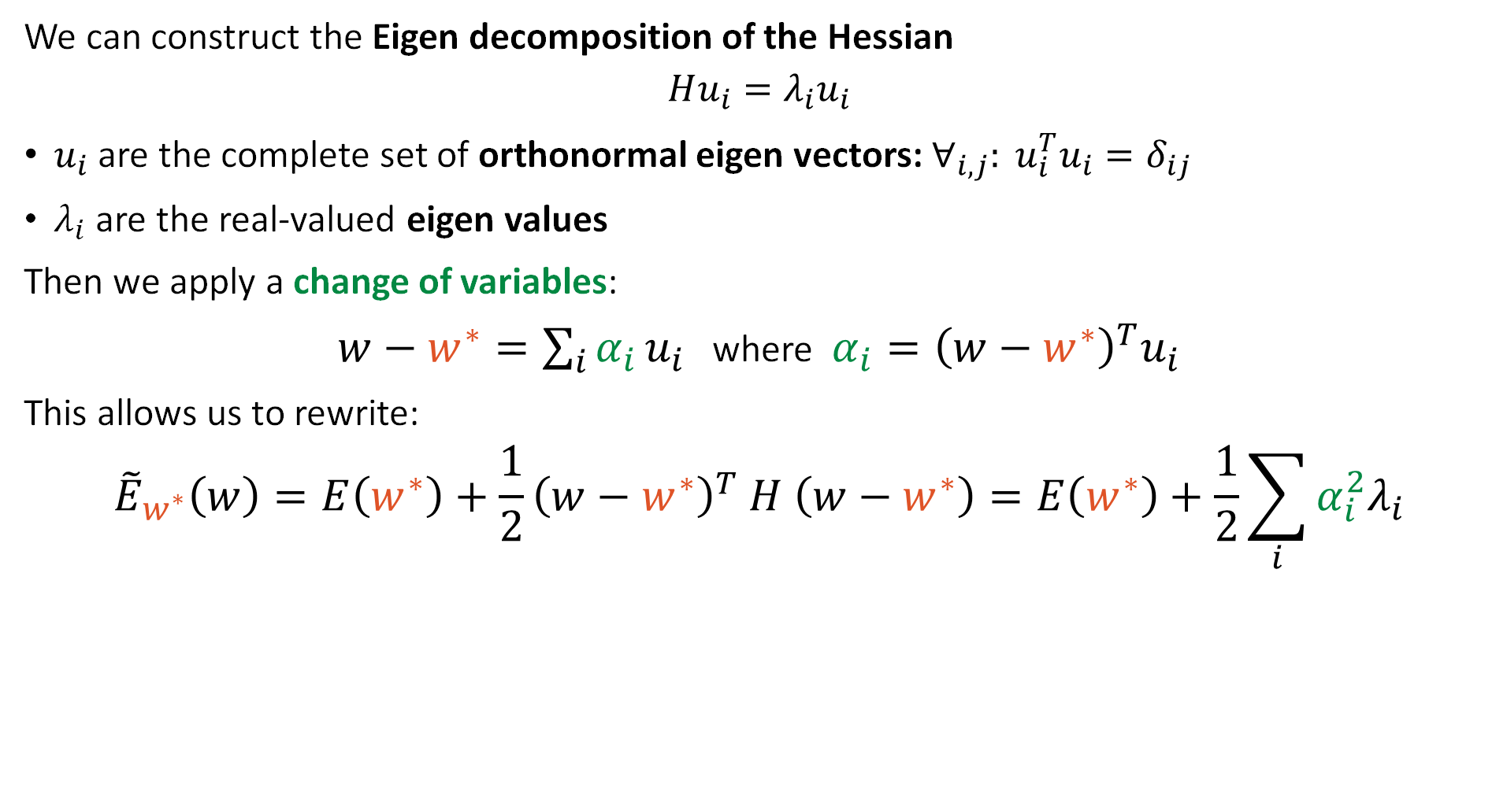
Eigen Decomposition of the Hessian
We can construct the Eigen decomposition of the Hessian
$$Hu_{i}=λ_{i}u_{i}$$
$u_{i}$ are the complete set of orthonormal eigen vectors: $∀_{i,j}: u_{i}^{T}u_{i}=δ_{ij}$
$λ_{i}$ are the real-valued eigen values
Then we apply a change of variables:
$w−w^{∗}=\sum_{i}{α_{i}}u_{i}$ where $α_{i}={\left(w−w^{∗}\right)}^{T}u_{i}$
This allows us to rewrite:
$${\tilde{E}}_{w^{∗}}\left(w\right)=E\left(w^{∗}\right)+\frac{1}{2}{\left(w−w^{∗}\right)}^{T} H \left(w−w^{∗}\right)=E\left(w^{∗}\right)+\frac{1}{2}\sum_{i}{α_{i}^{2}λ_{i}}$$
Show it!
Notes:
\alpha = U^T (w-w^*)
U * \alpha = U * U^T (w-w^*) = w-w^*

Slide 51
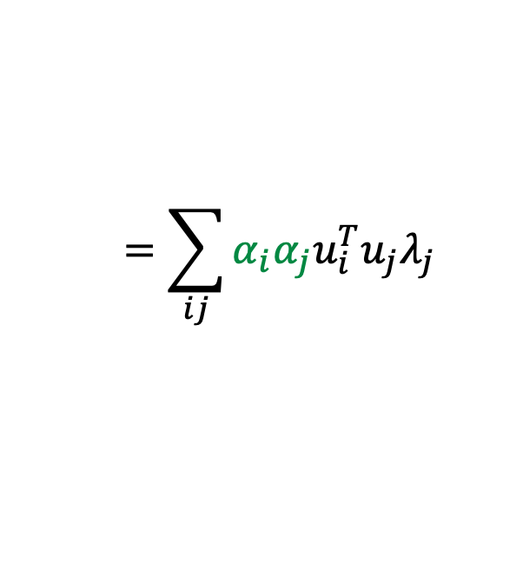







Eigen Decomposition of the Hessian
We can construct the Eigen decomposition of the Hessian
$$Hu_{i}=λ_{i}u_{i}$$
$u_{i}$ are the complete set of orthonormal eigen vectors: $∀_{i,j}: u_{i}^{T}u_{i}=δ_{ij}$
$λ_{i}$ are the real-valued eigen values
Then we apply a change of variables:
$w−w^{∗}=\sum_{i}{α_{i}}u_{i}$ where $α_{i}={\left(w−w^{∗}\right)}^{T}u_{i}$
This allows us to rewrite:
$${\tilde{E}}_{w^{∗}}\left(w\right)=E\left(w^{∗}\right)+\frac{1}{2}{\left(w−w^{∗}\right)}^{T} H \left(w−w^{∗}\right)=E\left(w^{∗}\right)+\frac{1}{2}\sum_{i}{α_{i}^{2}λ_{i}}$$
Show it!
Derivation:
$${\left(\sum_{i}{α_{i}}u_{i}\right)}^{T} H \left(\sum_{i}{α_{i}}u_{i}\right)$$
$$={\left(\sum_{i}{α_{i}}u_{i}\right)}^{T} \left(\sum_{i}{α_{i}}Hu_{i}\right)$$
$${\left(w−w^{∗}\right)}^{T} H \left(w−w^{∗}\right)=$$
$$={\left(\sum_{i}{α_{i}}u_{i}\right)}^{T} \left(\sum_{i}{α_{i}}λ_{i}u_{i}\right)$$
$$=\sum_{ij}{α_{i}α_{j}u_{i}^{T}u_{j}λ_{j}}$$
$$=\sum_{ij}{α_{i}α_{j}δ_{ij}λ_{j}}$$
$$=\sum_{i}{α_{i}^{2}λ_{i}}$$
Eigenvector Defn.
Orthonormality
Notes:
\alpha = U^T (w-w^*)
U * \alpha = U * U^T (w-w^*) = w-w^*

Slide 52

Taylor Expansion at the Stationary Pts.
If $\hat{w}$ is a stationary point ($w^{∗}$) (where $b=∇E{\left.​\right|}_{w=\hat{w}}=0$)
$${\tilde{E}}_{w^{∗}}\left(α\right)=E\left(w^{∗}\right)+\frac{1}{2}\sum_{i}{α_{i}^{2}λ_{i}}$$
At $α=0$ we get the error at the critical point $E\left(w^{∗}\right)$.
If we move in direction $i$ (corresponding to $u_{i}$) then $α_{i}^{2}$ increases.
The change in error then depends on the sign of $λ_{i}$
Therefore, if the eigenvalues are
all positive then $w^{∗}$is a local minimum.
all negative then $w^{∗}$is a local maximum.
mixed then $w^{∗}$is a saddle point.
Notes:
Move the goal earlier and then the derivation

Slide 53
Stationary Points and the Hessian
Eigenvalues of the Hessian determine the curvature at the critical points
Minimum
Maximum
Saddle Point

Slide 54




Eigenvector of the Hessian
Elliptical contours of constant error align with the eigenvectors of the Hessian matrix.
Direction with Smallest Eigenvalue
$$u_{1}$$
$$w^{∗}$$
$$u_{2}$$
Direction with Largest Eigenvalue
Plots in demo notebook.

Slide 55

Demo
Taylor Expansions and the Hessian

Slide 56





Recap: Quadratic Approx. Error
We constructed the 2nd-order Taylor expansion of the error surface at the stationary point $w^{∗}$ (where $b=∇E{\left.​\right|}_{w=w^{∗}}=0$):
$${\tilde{E}}_{w^{∗}}\left(w\right)=E\left(w^{∗}\right)+\frac{1}{2}{\left(w−w^{∗}\right)}^{T} H \left(w−w^{∗}\right)$$
Using the Eigen-decomposition of the Hessian: $Hu_{i}=λ_{i}u_{i}$we applied a change of variables $α_{i}={\left(w−w^{∗}\right)}^{T}u_{i}$ to obtain:
This is minimized at $α=0$
We can evaluate gradient descent on this simple quadratic approximation to better understand the convergence properties.
$${\tilde{E}}_{w^{∗}}\left(α\right)=E\left(w^{∗}\right)+\frac{1}{2}\sum_{i}{α_{i}^{2}λ_{i}}$$
$$u_{1}$$
$$w^{∗}$$
$$u_{2}$$

Slide 57



Grad. Descent on the Quadratic Approx.
Quadratic Approx. Error
Compute the gradient with respect to $α_{i}$:
$$\frac{∂}{∂α_{i}}{ \tilde{E}}_{w^{∗}}\left(α\right)=α_{i}λ_{i}$$
Which gives the gradient descent update:
$$α_{i}^{(τ)}=α_{i}^{(τ−1)}−η\left(α_{i}^{\left(τ−1\right)} λ_{i}\right)=\left(1−ηλ_{i}\right)α_{i}^{\left(τ−1\right)}$$
If we iteratively apply the gradient descent update, we obtain:
$α_{i}^{(1)}=\left(1−ηλ_{i}\right)α_{i}^{\left(0\right)}$ ➔ $α_{i}^{(2)}=\left(1−ηλ_{i}\right)\left(\left(1−ηλ_{i}\right)α_{i}^{\left(0\right)}\right)$ ➔ … ➔
$${\tilde{E}}_{w^{∗}}\left(α\right)=E\left(w^{∗}\right)+\frac{1}{2}\sum_{i}{α_{i}^{2}λ_{i}}$$
$$α_{i}^{(τ)}={\left(1−ηλ_{i}\right)}^{τ}α_{i}^{\left(0\right)}$$

Slide 58


Grad. Descent on the Quadratic Approx.
Assuming a quadratic approximation to the error function around the minima, the $τ^{th}$ iteration of gradient descent we have:
and the error is minimized when $α_{i}=0$.
To ensure $α_{i}^{(τ)}→0$ as $τ→∞$ the learning rate should satisfy:
$\left|1−ηλ_{i}\right|<1$ (Convergence Condition)
Smaller $\left|1−ηλ_{i}\right|$ is better (converges faster)
Negative $1−ηλ_{i}<0$ oscillatory behavior
$$α_{i}^{(τ)}={\left(1−ηλ_{i}\right)}^{τ}α_{i}^{\left(0\right)}$$

Slide 59



Learning Rate Impact on Convergence
To maximize the progress on each step of gradient descent we want to make $η$ as large as possible (take bigger steps)
We want ${\left(1−ηλ_{i}\right)}^{τ}→0$ quickly as $τ$ increases (larger $η$ ➔ smaller $1−ηλ_{i}$).
However, to ensure convergence we require $\left|1−ηλ_{i}\right|<1$ for all $λ_{i}$
Let $λ_{min}$ and $λ_{max}$ be the smallest and largest eigenvalues of the Hessian
Then $η<\frac{2}{λ_{max}}$ because if $η≥\frac{2}{λ_{max}}$ then $\left|1−ηλ_{max}\right|≥1$
The slowest converging dimension correspond to $λ_{min}$ so the smallest we can make $\left(1−ηλ_{i}\right)$:
$$\left(1−\frac{2}{λ_{max}}λ_{min⁡}\right)$$
$$<\left(1−ηλ_{i}\right)$$

Slide 60








Condition Number and Loss Surface
The slowest converging dimension ($i$) is the dimension corresponding to $λ_{min}$ and its convergence to 0 is lower bounded by:
$$τ$$
$$\left(1−\frac{2}{λ_{max}}λ_{min⁡}\right)$$
$$α_{i}^{\left(0\right)}$$
Direction with Smallest Eigenvalue
The ratio of $\frac{λ_{min}}{λ_{max}}$ is the condition number.
A problem is said to be well conditioned if it has a large condition number.
Gradient descent converges quickly on well conditioned problems.
$$u_{min}$$
$$w^{∗}$$
$$u_{max}$$
Direction with Largest Eigenvalue

Slide 61


Issues with Gradient Descent (GD)
GD converges slowly when the error surface is relatively flat:
GD oscillates when the error surface is poorly conditioned
Step size
(learning rate $η$) is too small.
Step size
(learning rate $η$) is too big.

Slide 62
Demo
Batch Gradient Descent

Slide 63

Momentum
Momentum can be used improve convergence in these settings by accumulating common update directions
$$Δ{\text{w}}^{\left(τ−1\right)}=−η ∇E\left({\text{w}}^{\left(τ−1\right)}\right)+μ Δ{\text{w}}^{\left(τ−2\right)}$$
$${\text{w}}^{\left(τ\right)}={\text{w}}^{\left(τ−1\right)}+Δ{\text{w}}^{\left(τ−1\right)}$$
$0≤μ<1$ ($μ=0.9$) is the momentum hyperparameter
We now need to maintain the previous $Δ{\text{w}}^{\left(τ−2\right)}$ update direction
Intuition: The solution “picks up speed” along the direction of repeated updates.

Slide 64

How Momentum Helps: Flat Directions
In directions that are relatively flat (e.g., is approx. constant $∇E$):
$$Δ{\text{w}}^{\left(∞\right)}=−η ∇E+μ \left(−η ∇E+μ \left(−η ∇E+μ \left(…\right)\right)\right)$$
$$Δ{\text{w}}^{\left(∞\right)}=−η ∇E\left(1+μ+μ^{2}+μ^{3}+…\right)=− \left(\frac{η}{1−μ}\right)∇E$$
The momentum parameter $μ$ increases the effective learning rate
Remember that $0≤μ<1$ and therefore $η≤\left(\frac{η}{1−μ}\right)$
Geometric Series

Slide 65

How Momentum Helps: Oscillations
In directions that are steep (e.g., oscillating sign $∇E$):
$$Δ{\text{w}}^{\left(τ\right)}=−η ∇E+μ \left(−η \left(−∇E\right)+μ \left(−η ∇E+μ \left(…\right)\right)\right)$$
$$Δ{\text{w}}^{\left(∞\right)}=−η ∇E\left(1−μ+μ^{2}−μ^{3}+…\right)=− \left(\frac{η}{1+μ}\right)∇E$$
The momentum parameter $μ$ decrease the effective learning rate
Remember that $0≤μ<1$ and therefore $\left(\frac{η}{1+μ}\right)≤η$
Alternating Geometric Series

Slide 66

Demo
Mini-batch Gradient Descent

Slide 67
Optimization and Gradient Descent
Lecture 12
Credit: Joseph E. Gonzalez and Narges Norouzi
Reference Book Chapters: Chapter 7

